Slide 1
Halcon Parallelization

Slide 2
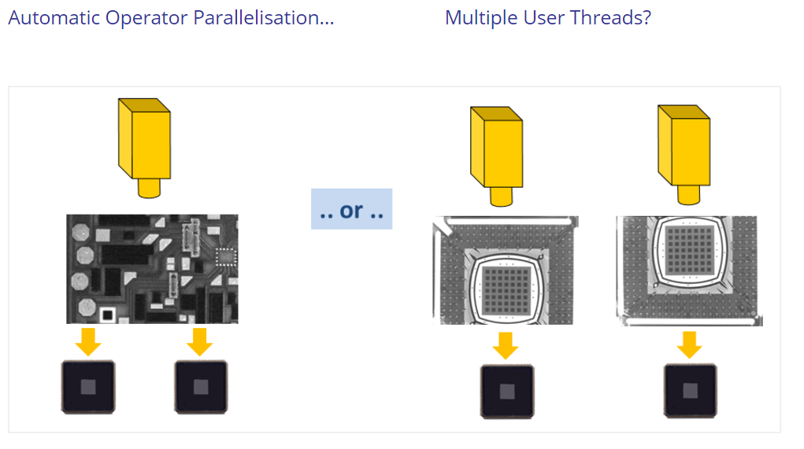
set_system(‘tsp_thread_num’, 4)
set_system(‘tsp_thread_num’, 2)
set_system(‘tsp_thread_num’, 2)

Slide 3
Automatic Parallelization Method Data parallelism @ one function for CPU
Tuple level
Array of images with same condition
Data trigger
Channel level
Many input sources
Hardware trigger
Domain level
Partition of one image
Flow trigger
Internal data level
Using Multi cores inside function
Compute device

Slide 4
Hierarchy
Process
Operator
Operator
Thread
Thread
Thread
Image

Slide 5
Mode
SISO
MISO
Image
Function
Operator
Image
Image
Function
Operator
Image
Image
Image
Image
Image
SIMO
MIMO
Image
Function
Operator
Image
Image
Function
Operator
Image
Function
Operator
Image
Image
Function
Operator
Image

Slide 6
Reentrancy mode: one Halcon process
Reentrant: I/O data should be independent
Local:
Single write multiple read: I/O process control
Mutually exclusive
multi-threads of certain operator
many operators
Exclusive: certain operator occupy one process
Independent: among processes

Slide 7
Issue at optimization
Threads number ≤ cores number
Local variables inside thread
Initialization: for each operator
I/O and visualization: occupy operator
Multithreading or automatic parallelization: trade-off
HALCON/COM: different code languages

Slide 8
Memory limitation
Compute device buffer
1.8GB on GTX 960M
Tesla P100 16GB
Single Image size
Max 32k x 32k pixels
No limit at HalconXL
Flow dependence
Time of Mem copy > process
Reuse read only data
Copy data between devices

Slide 9
Additional Information
Customizing the Parallelization Mechanisms
get_system('processor_num', Information)
set_system(‘tsp_thread_num’, 4)
set_system('parallelize_operators','false')
set_system('reentrant','false')
Spinlocks, the HALCON thread pool and real-time scheduling
‘HSetUseSpinLock(0)’
Hyper-threading reduce performance

Slide 10
Implement Model
Performs image acquisition, processing, and display in three threads
c#\MultiThreading
Executes the same HDevelop procedure in parallel by two threads using HDevEngine
hdevengine\c#\MultiThreading
Executes different HDevelop procedures in parallel by two threads using HDevEngine
hdevengine\c#\MultiThreadingTwoWindows

